Slide 1
State of Michigan Tax Return
Tax Year 2023
This seminar is ONLY for international students and scholars who lived and earned money in ONLY the state of Michigan 2023. Lived in Michigan and another U.S. state during 2023? See our SOM Multistate Nonresident Return Presentation on taxclinic.law.msu.edu.
This seminar is provided for informational purposes only. Your circumstances may be different. We have drafted this to inform nonresident aliens on their filing obligations. Contact a tax professional if you have additional questions.

Slide 2
Documents Needed to Complete Michigan Tax Return
Federal Form 1040NR
All income year end statements you used to complete your 1040NR (examples are W-2, 1099-NEC, 1042-S, etc.)
Any tax document that reported Michigan withholding.
Michigan Forms we will cover in this seminar:
Michigan 1040
Michigan Schedule 1
Michigan Schedule NR
Michigan Schedule W

Slide 3
Form MI-1040
Line 1 - Enter your name and United States address
Line 2 - Enter your Social Security Number or ITIN
Line 3 - Leave blank unless you are filing jointly
Line 4 - Enter “10000” “Nonresident” for School District Code

Slide 4
Line 5 and 6
Line 5 asks if you want $3 of the tax you pay to go to a fund for politicians to run for office. This does not change your tax bill. It merely takes $3 of what they have collected from you and places it into this fund.
Line 6 is skipped because you are not a farmer, fishermen, or seafarer.

Slide 5
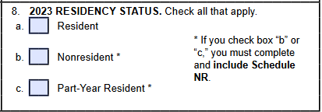
Filing Status & Residency Status
Line 7
Select the same status as you used on your federal form.
If you are married, this is most likely
“married filing separately. ”
Line 8 - Check “Nonresident” box

Slide 6
MI-1040 page 1, continued
Line 9. Exemptions
Enter the number of people you are claiming on your return. Most international students can only enter 1 in box 9a.
Multiply line 9a by $5,400
Enter the same amount that is on line 9a in box 9f
Notes:
Not sure about line 9

Slide 7
Michigan 1040 page 1, continued
Line 10. Adjusted Gross Income - You will need to look at the federal tax return Form 1040NR
In the federal return - Form 1040-NR (look in upper left corner of the form to confirm form number), then copy the amount from line 11 from your federal 1040NR to line 10 on your Michigan tax return.

Slide 8
MI-1040 page 1, continued
Line 11 – Enter 0, because these do not apply to you.
Line 12 - Add together the numbers in line 10 and line 11

Slide 9
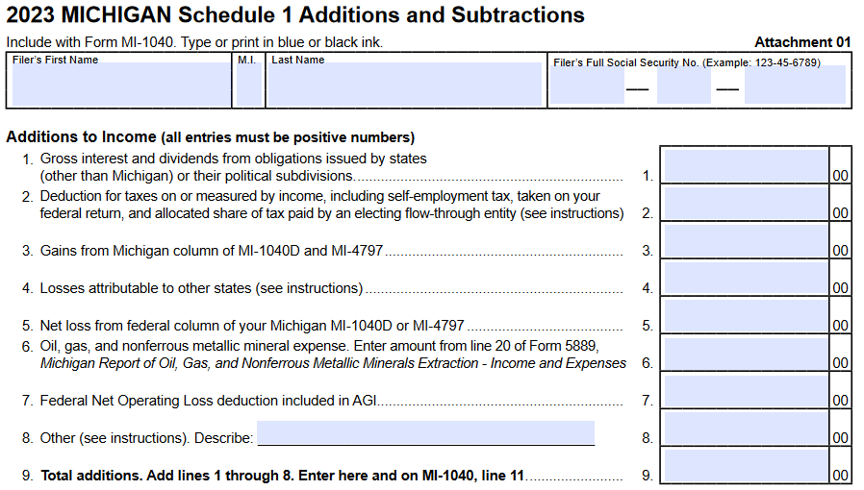
SWITCH FORMS to Schedule 1
Switch forms to calculate what amount goes on Line 11 and Line 13 of your Michigan tax return. Continue to next slide.

Slide 10
Schedule 1 – Additions and Subtractions*
This step ONLY applies to taxpayers who received a state of Michigan tax refund last year. If you received the postcard 1099-G last year, it should have “2023” on it.
Put your name and social security number or ITIN on the top of both pages
If you got a state tax refund last year you should have received a 1099-G postcard.
Lines 1-9 on page 1 – Skip because these do not apply to you
* If you earned income in more than one U.S. state in 2023, your Schedule 1 will be different. Please refer to our other Michigan presentation for those who earned income in Michigan and another state on our website

Slide 11
SWITCH FORMS back to Schedule 1
Lines 10-15 – Skip because these do not apply to you
Line 16 - Put the number from your 1099-G on line 16 of Schedule 1
Lines 17-28 – Skip
Line 29 - Copy the number from line 16
Line 30 - Skip
Line 31 - Copy the number from line 29 and then switch back to the main form and carry this number to line 13

Slide 12
MI-1040 page 1, continued
Line 13
You will need to look at your Schedule 1 line 31 and transfer that number to line 13 here
If this is your first year filing Michigan taxes or you did not receive a Michigan refund last year, enter 0 (zero)
Line 14 - Subtract line 13 from line 12 (line 12 minus line 13). If line 13 is larger than line 12, enter 0 (zero)
Notes:
Line 15?

Slide 13
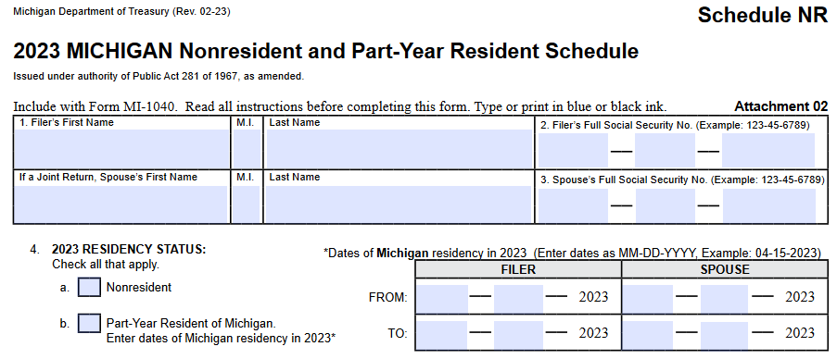
SWITCH FORMS to Schedule NR

Slide 14
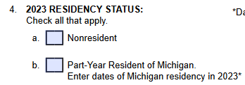
Schedule NR
Line 1
Fill in your name
Line 2
Fill in your Social Security number or ITIN
Line 3
Skip, unless you are filing jointly
Line 4
Select nonresident, even if you moved into Michigan during the year. If you are a federal nonresident, you are a Michigan nonresident for tax purposes

Slide 15
Schedule NR, continued
This form is to demonstrate to the state how much of that $5,400 of personal exemption you should receive. In the table, you will only be using Column A and B. Skip column C unless you worked and lived in another state last year (then you should check the SOM Multistate presentation at taxclinic.law.msu.edu).
Line 5 - Copy the number from line 10 of your MI-1040 into Column A and Column B
Lines 6-11 - Skip
Line 12 - Copy the number from line 5 (enter in both column A and B)
Line 13 – Skip
Line 14 - Copy the number from line 5 (enter in both column A and B)
Line 15 - Copy the number from line 9f of your MI-1040

Slide 16
Schedule NR, continued
Line 16 - Enter the number from line 14, column B
Line 17 - Enter the number from line 14, column A (Lines 16 and 17 should be the same number)
Line 18 - Enter “100”
Line 19 - Copy the number from line 15

Slide 17
SWITCH FORMS to MI-1040 page 1
Line 15 - Copy the number from line 19 of your Schedule NR
Line 16 - Subtract line 15 from line 14 (line 14 minus line 15). If line 15 is larger than line 14, enter 0 (zero).
Line 17 - Multiply the number in line 16 by 4.05% (0.0405)

Slide 18
MI-1040 page 2
Enter your Social Security Number or ITIN on the top of page 2
Lines 18 and 19 – Skip because they do not apply to nonresident aliens
Line 20 - Copy in the number from line 17
Line 21 and 22 - Skip

Slide 19
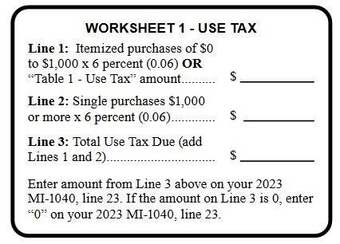
MI-1040 page 2
Line 23 Use Tax Use tax is a tax on purchases you made outside of Michigan, but then brought that property into Michigan either by shipping or personal carry. You must add up all purchases you made (online or outside of the state) but did not pay Michigan sales tax on. Then multiply that number by 6% and enter that amount on Line 23. You can use an alternate calculation based on your income, which is in the instructions for MI Form 1040. The Instructions also have “Worksheet 1” (pictured here) to help you with the calculation. The worksheet does not need to be included with your return. You can use the one on this page.

Slide 20
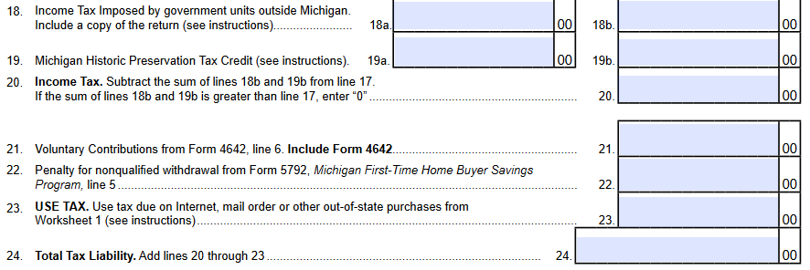
MI-1040 page 2, continued
Line 24 - Add together lines 18 through 23 and enter the total in line 24.
Lines 25-29 – Skip because these do not apply to nonresident aliens

Slide 21
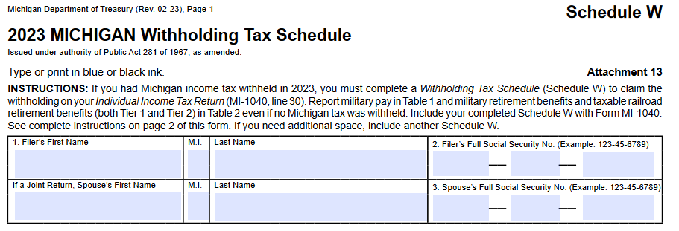
SWITCH FORMS to Schedule W

Slide 22
Schedule W
Line 1 - Enter your Name
Line 2 - Enter your Social Security Number or ITIN
Line 3 - Skip, unless you are filing jointly

Slide 23
Schedule W - Table 1 – W-2’s
Transfer all information from your W-2s into Table 1
For each of your W-2’s, you will enter the following information into one line of the Table 1:
Column A - Check the “filer” box (you will only check the box for your spouse’s W2s if you are filing jointly)
Column B – Enter your employer’s EIN (box b on your W2)
Column C – your employers name (box c on your W2)
Column D - your wages (box 1 from your W2)
Column E – Michigan income tax withheld (box 17 from you W2)

Slide 24
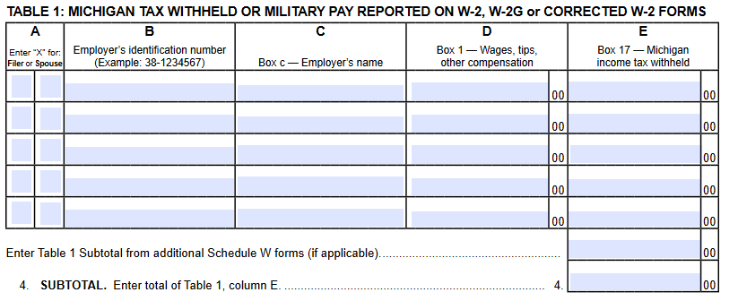
Schedule W – Table 1
Line 4 - Add together everything from Table 1, column E

Slide 25
Schedule W – Table 2
Enter your information from your 1042-S (if applicable) in table 2
Column A – Check “filer” (you will only enter your Spouses W2s if you are filing jointly)
Column B – Payer’s EIN or TIN (line 12a of 1042-S)
Column C – Payer’s Name (line 12d of 1042-S)
Column D - Taxable pension distribution, misc. income (box 2 of 1042-S)
Column E – Michigan tax withheld (box 17a of 1042-S)

Slide 26
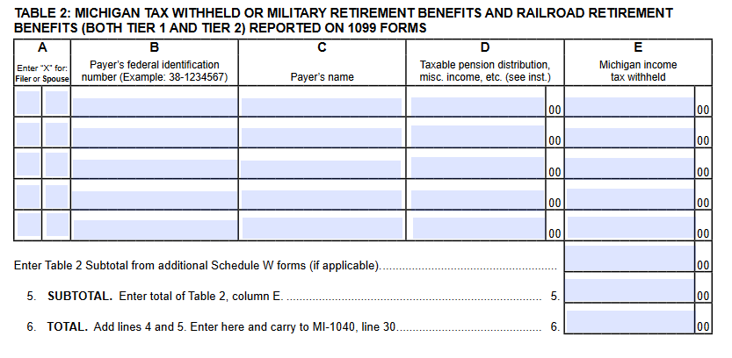
Schedule W, continued
Line 5 - Add together everything from Table 2, column E
Line 6 - Add together line 4 and line 5

Slide 27
SWITCH FORMS back to MI-1040, page 2
Line 30 - Enter the amount from line 6 of your Schedule W on line 30
Line 31 and 32 - Skip
Line 33 – Enter the amount that is on line 30 above.

Slide 28
MI-1040 page 3
Enter your Social Security Number or ITIN on the top of page 3
Lines 34 and 35 (You will fill in ONE of either line 34 OR 35)
If line 24 is larger than line 33, subtract line 33 from 24 (line 24 minus line 33) and put that number in the box on line 34
If line 33 is larger than line 24, subtract line 24 from line 33 (line 33 minus line 24) and put that number in the box on line 35
Line 36 – Skip
Line 37 - If you have a number in line 35, copy it to line 37

Slide 29
Direct Deposit
If you have a number in line 34, you owe additional tax. See next slide for payment instructions.
If you have a number in line 37, you are receiving a refund. You can receive this by direct deposit or check
If you are receiving a refund and want the state to deposit it directly into your bank account, enter your information
DOUBLE CHECK THAT YOU ENTERED THE CORRECT INFORMATION
Neither the state nor your financial intuition will confirm your information
If you enter the wrong information, it will be VERY DIFFICULT OR IMPOSSIBLE TO FIX

Slide 30
How to pay State of Michigan
Insert information about enclosing check or money
Insert link to pay online - also link to payment instructions Powerpoint on website?

Slide 31
Filing your Michigan tax return
Forms to send for state of Michigan income tax returns:
MI-1040
Schedule W
Schedule 1
Schedule NR
Copy of your Federal 1040NR form
Where to mail?
Are you receiving a refund or have zero due/zero refund?
Michigan Department of Treasury
Lansing, MI 48956
Is there additional tax due?
Michigan Department of Treasury
Lansing, MI 48929

